Slide 1
Brief on RFCs
By Anisetty Anudeep

Slide 2



What is RFCs
Request for Comments
Invented by Steve Crocker in 1969
Publication from IETF
8,650 RFCs in total as of 2019
They are never modified
Unofficial and Experimental in nature

Slide 3
Why RFCs
develop a "standard" network protocol
they provide a written record of the evolution of the Internet standards and practices.
shape the Internet's inner workings and have played a significant role in its success
They are basic building blocks of internet

Slide 4
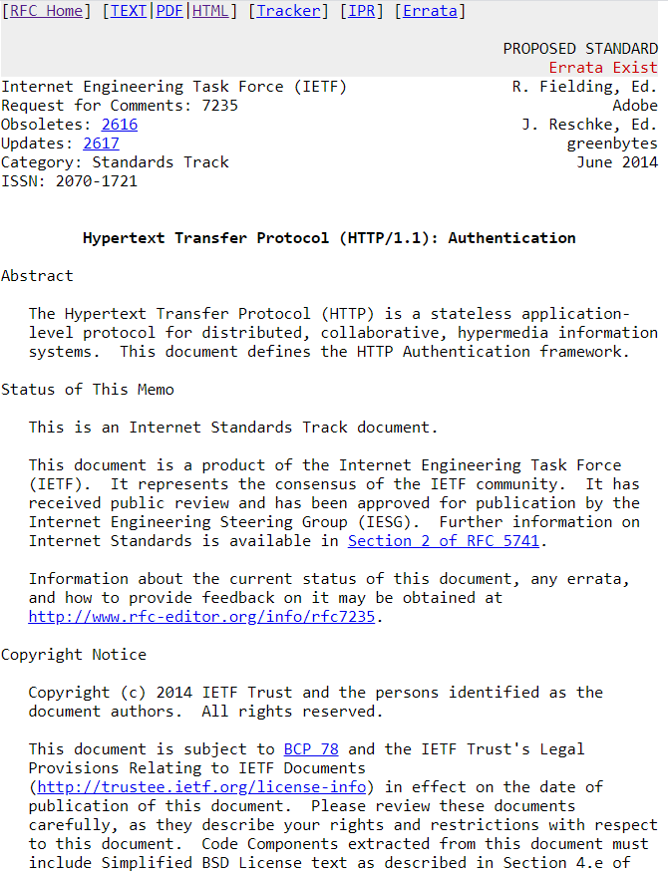
Look at this
Example of RFC
This example represents Request for comments for HTTP/1.1

Slide 5
Types of RFC
Standards Track
Informational
Experimental
Best Current Practice
Historic
Unknown

Slide 6
Conclusion
A Request for Comments (RFC) is a publication from the Internet Society (ISOC) and its associated bodies
Initial purpose of RFC's was to help out the developers working on ARPANET to have an unofficial documentation of the project. RFCs were actual Requests for Comments and were titled as such to avoid sounding too declarative and to encourage discussion.
RFC leaves questions open and is written in a less formal style.

